Slide 1
GENETIC ALGORITHMS
Reported By: Team #11
Gaurang Davda
Ridhima Sawhney

Slide 2

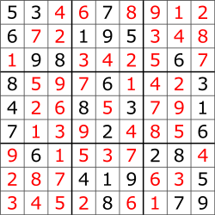
Problem
Solving Sudoku using Genetic Algorithm
A number placement puzzle in which players insert the numbers one to nine into a grid consisting of nine squares subdivided into a further nine smaller squares in such a way that every number appears once in each horizontal line, vertical line, and square.
Sudoku

Slide 3
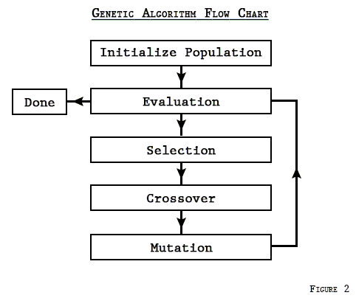
Our Implementation
Chromosome(Sudoku) input represents the base Gene which is modified by putting random integers in empty places
The fitness of the Chromosome is evaluated and the fittest Chromosome from the population is selected
If the fitness is not equal to 0 (optimal solution). Then, 60% of the unfit population is culled
Crossover or mutation is randomly performed on the remaining 40% of the fit population and a new generation of Chromosomes are created from them
The fittest Chromosome is selected from this new population and it loops this process until fitness reduces to 0

Slide 4
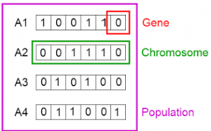
Genetic Code
The initial base gene of a Sudoku is defined in the program, which contains empty spaces (represented by 0s)
Random permissible numbers are generated which replaces empty spaces (0s) in the initial gene and a new gene is formed out of it
The new gene formed is stored separately in the Chromosome and all the operations are performed on it

Slide 5
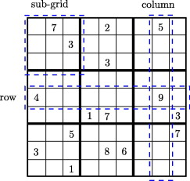
Fitness Function
Fitness Function is determined by validating all the 3 traits of Sudoku:
Rule of the row
Rule of the column
Rule of the individual block
Fitness is inversely proportional to the solution, lesser the fitness value, better the solution

Slide 6
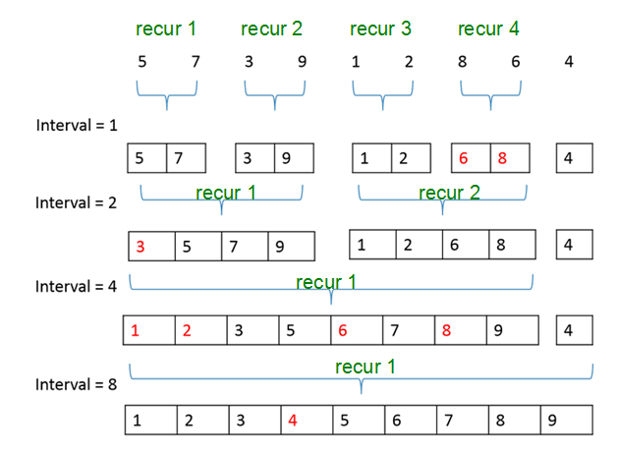
Sort Function
Merge sort has been used in the program to sort the array of chromosomes based on their fitness
The Chromosomes implements Comparable interface
Chromosome overrides the compareTo() which determines the smaller of the two fitness values

Slide 7
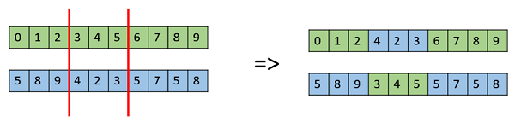
Evolution Mechanism
Randomly, a Cross-Over or Mutation is performed on the fit chromosomes to create new off-springs.
Cross-Over
Multi-point cross-over has been used in the program where alternating gene segments are swapped to get new off-springs.
Mutation
Random resetting mutation has been used, where, a random value from the set of permissible values is assigned to a randomly chosen gene

Slide 8

Unit Tests
We have tested our program on the following fronts
Sorting Function
Incorrect Input
9*9 Easy Sudoku
9*9 Hard Sudoku
6*6 Easy Sudoku
6*6 Hard Sudoku
4*4 Easy Sudoku
4*4 Hard Sudoku

Slide 9
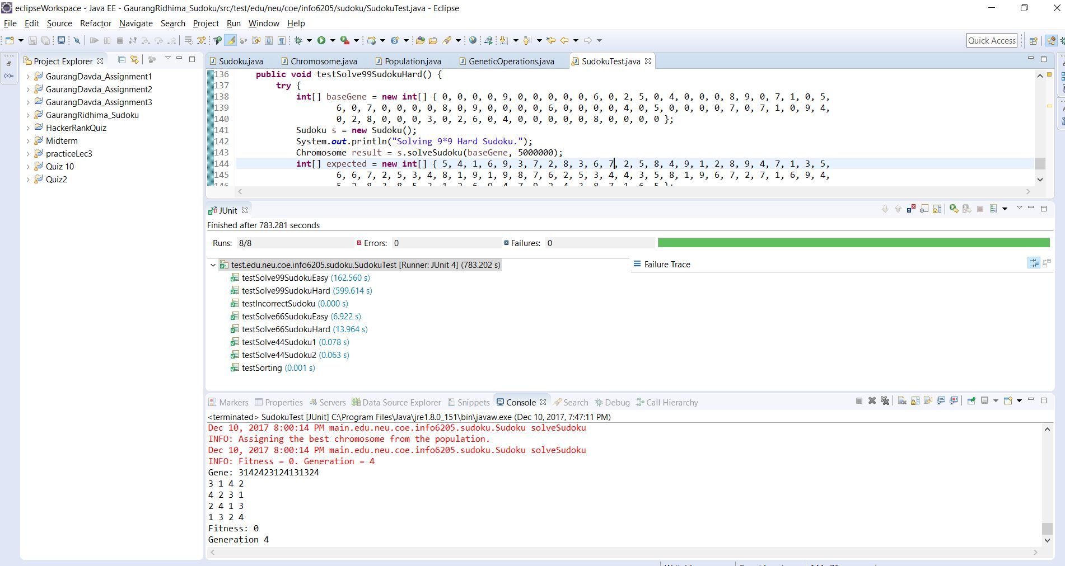
Working Screenshot

Slide 10
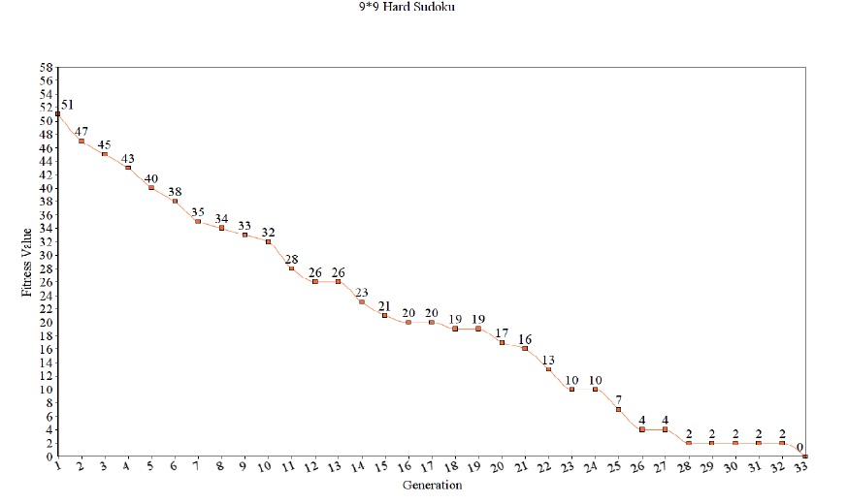
Analysis

Slide 11
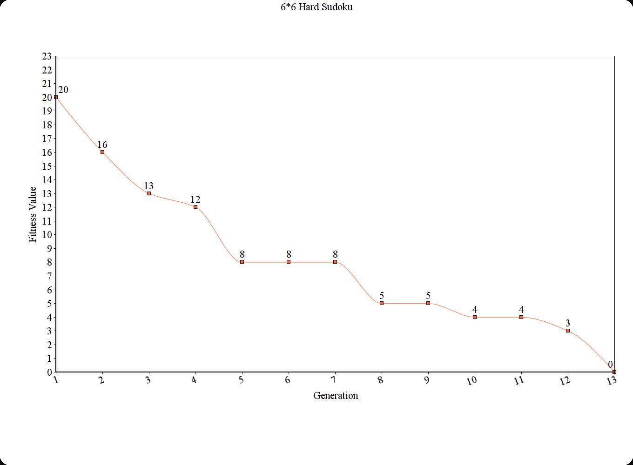
Analysis (Contd..)

Slide 12
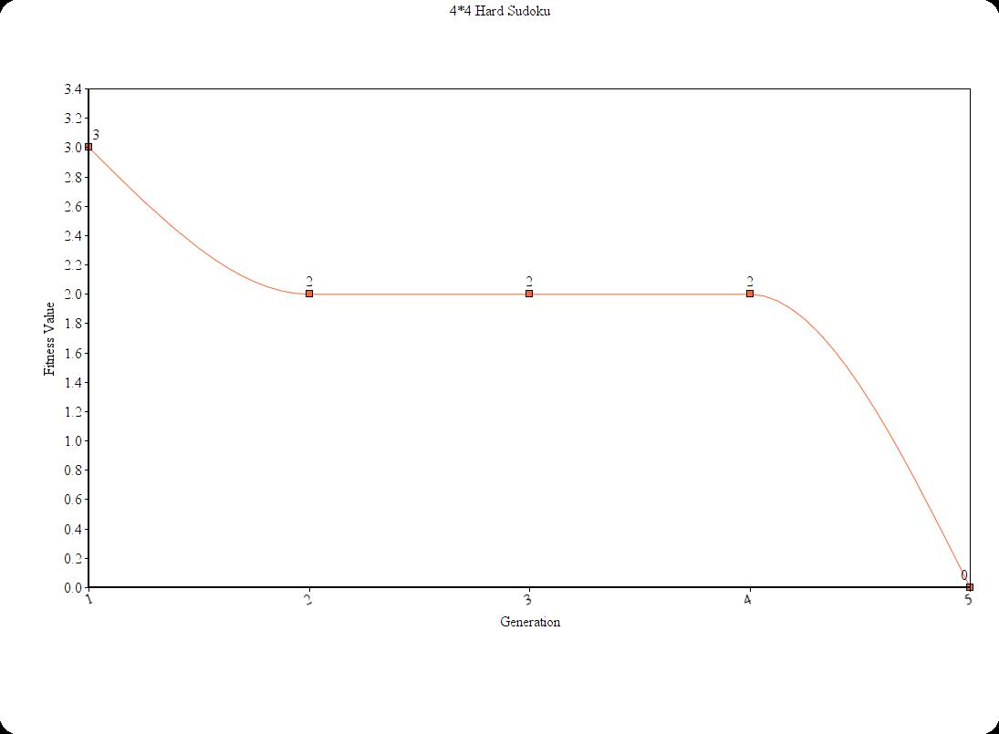
Analysis (Contd..)

Slide 13

Conclusion
Sudoku is a GA-hard problem
Solving a Sudoku using GA requires large population space, where, population space depends on the dimension of the puzzle. In our implementation, as Sudoku size increased from 4*4 to 9*9, our population count increased from 10,000 to 5 million
The algorithm heavily relies on the fitness of the survivor population, cross-overs and random mutations for creation of a new generations
The algorithm has a slow converging rate due to random mutation and may also get stuck on a local optima, from which, it can seldom jump out and find the best solution

Slide 14
Thank You!

